Slide 1
SIGN LANGUAGE RECOGNITION

Slide 2
WHAT IS SIGN LANGUAGE ?
Wherever vocal communication is impossible, when one or more would-be communicators is deaf, sign language can be used to bridge the gap.
any means of communication through bodily movements, especially of the hands and arms, used when spoken communication is impossible or not desirable.
There are many different sign languages as, British, Indian and American sign languages. British sign language (BSL) is not easily intelligible to users of American sign Language (ASL) and vice versa .

Slide 3
What is sign language recognition ?
Sign Language Recognition (shortened generally as SLR) is a computational task that involves recognizing the signs and gestures shown by the user into text. This is an essential problem to bridge the communication gap that is faced by people with hearing impairments and the general public.

Slide 4
History of sign language
The recorded history of sign language in Western societies starts in the 17th century, as a visual language or method of communication, although references to forms of communication using hand gestures date back as far as 5th century BC Greece.
Sign language is composed of a system of conventional gestures, mimic, hand signs and finger spelling, plus the use of hand positions to represent the letters of the alphabet. Signs can also represent complete ideas or phrases, not only individual words.
Most sign languages are natural languages, different in construction from oral languages used in proximity to them, and are employed mainly by deaf people in order to communicate.
Many sign languages have developed independently throughout the world, and no first sign language can be identified. Both signed systems and manual alphabets have been found worldwide.
Until the 19th century, most of what we know about historical sign languages is limited to the manual alphabets (fingerspelling systems) that were invented to facilitate transfer of words from an oral to a sign language, rather than documentation of the sign language itself.

Slide 5
Why do we need sign language recognition ?
Sign language interpreters help solve the communication gap with the hearing impaired by translating sign language into spoken words and vice versa.
Sign language recognition provides an efficient and accurate way to convert sign language into text or voice making it easier to communicate.
for example, or enabling very young children to interact with computers (recognizing sign language), among others.

Slide 6
The Working of real time sign language recognition using sequences
Extract holistic key points
Train an LSTM Deep Learning model
Make real time predictions using sequences

Slide 7
Required tools
Python
OpenCV: OpenCV is an open-source, highly optimized Python library targeted at tackling computer vision issues. It is primarily focused on real-time applications that provide computational efficiency for managing massive volumes of data. [ It processes photos and videos to recognize signs and gestures.
Mediapipe: MediaPipe is a Framework for building machine learning pipelines for processing time-series data like video, audio, etc. Here we’ll be using mediapipe holistics which is one of the pipelines which contains optimized face, hands, and pose components which allows for holistic tracking, thus enabling the model to simultaneously detect hand and body poses along with face landmarks.
TensorFlow: It is an open-source artificial intelligence package that builds models using data flow graphs. It enables developers to build large-scale neural networks with several layers. TensorFlow is mostly used for classification, perception, comprehension, discovery, prediction, and creation. An open source TensorFlow API to locate objects in an image and identify it.
Sklearn: Scikit-learn (Sklearn) is the most useful and robust library for machine learning in Python. It provides a selection of efficient tools for Machine learning and statistical modeling including classification, regression, clustering and dimensionality reduction via a consistence interface in Python.
Matplotlib: Matplotlib is a comprehensive library for creating static, animated, and interactive visualizations in Python. Matplotlib makes easy things easy and hard things possible.
Keras: Keras is used along with TensorFlow to build a deep neural network that leverages LSTM layers to handle the sequence of keypoints.

Slide 8
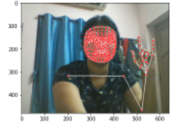
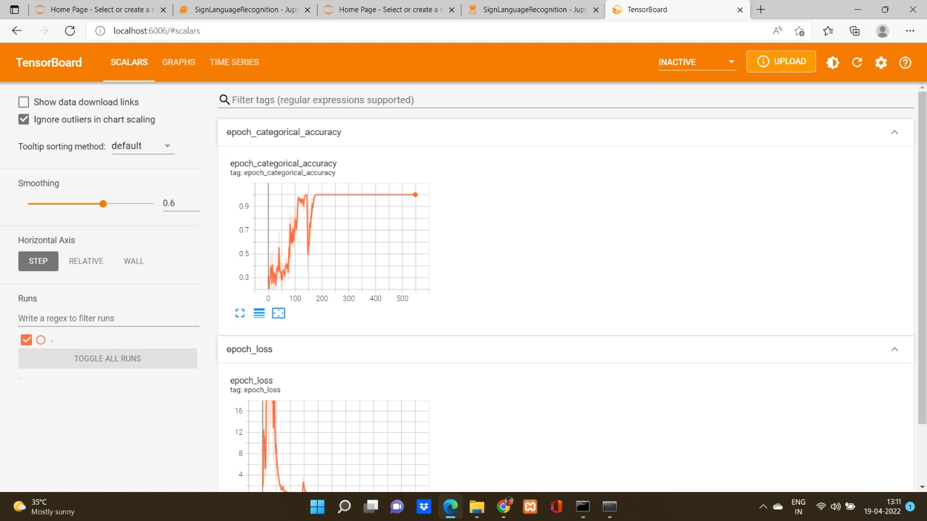
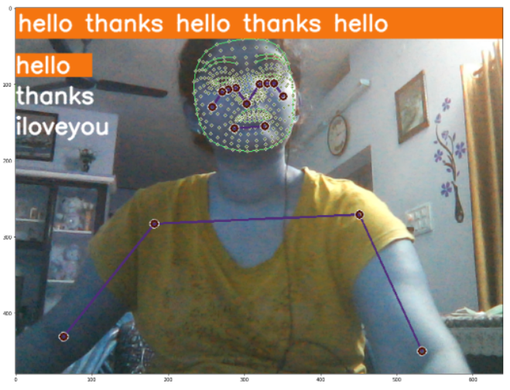
How it works
Collect keypoints from mediapipe holistic
Train a deep neural network with LSTM layers for sequences
Perform real time sign language recognition using OpenCV

Slide 9
Step by step working of sign language recognition
Installing and importing dependencies : Here we do install all the required tools i.e. TensorFlow, OpenCV, mediapipe, sklearn, matplotlib and import dependencies of NumPy, os, time and pyplot from matplotlib.
Keypoints using mediapipe holistic: Using mediapipe python framework we detect Hand, Face, and Pose Landmarks.
Extract Keypoints: We now extract all the keypoints detected using mediapipe holistic which are in return used for training and building our LSTM DL model.
Setup folders for data collection: Here we create folders to export the data to be stored as NumPy arrays.
Collect Keypoint sequences: We collect the sequences for training and testing the model.
Preprocess data and create labels: Here we preprocess the data, create labels and features to the collections which would be of help to detect the sign in real time.

Slide 10
Build & Train an LSTM deep learning model: Using TensorFlow and keras we build and train the model where the model summary, accuracy are defined.
Make sign language predictions: predictions are made using models from keras on the tested & trained model.
Save model weights
Evaluation: we import couple of metrics i.e. confusion matrix and accuracy from sklearn and evaluate the performance of the model.
Test in real time

Slide 11
applications
The dataset can easily be extended and customized according to the need of the user and can prove to be an important step towards reducing the gap of communication for dumb and deaf people.
Using the sign detection model, meetings held at a global level can become easy for the disabled people to understand and the value of their hard work can be given

Slide 12
limitations
They are costly and are difficult to be used commercially.
Limitations such as environmental factors like low light intensity and uncontrolled background which cause decrease in the accuracy of the detection.

Slide 13
Future scope
The implementation of our model for other sign languages such as Indian sign language or American sign language.
Further training the neural network to efficiently recognize symbols.
Enhancement of model to recognize expressions.
Instead of displaying letter labels it will be more appropriate to display sentences as more appropriate translation of language which results in the increase of readability.
More training data can be added to detect the letter with more accuracy.

Slide 14
Conclusion
Sign Language Recognition System has been developed from classifying only static signs and alphabets, to the system that can successfully recognize dynamic movements that comes in continuous sequences of images. Researcher nowadays are paying more attention to make a large vocabulary for sign language recognition systems. Many researchers are developing their Sign Language Recognition System by using small vocabulary and self-made database. Large database build for Sign Language Recognition System is still not available for some of the country that involved in developing Sign Language Recognition System. The classification method of identifying the sign language is also varied from researchers. Using their own ideas and limitations for the Sign Language Recognition System, the comparison of one method to another method is still subjective. Fair and direct comparison between approaches are limited because of the variation of sign language in different countries and the difference in limitation set by each researcher. Variation of sign language in most of the country is based on their grammar and their way to present each word, such as presenting the language by word or by sentence.

Slide 15
THANK YOU

